Slide 1
Probability Theory, Density Estimation

Slide 2

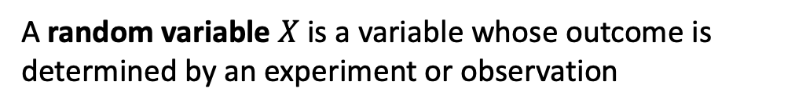
Random variable
A random variable $X$ is a variable whose outcome is determined by an experiment or observation

Slide 3

Sample space
The set of all possible outcomes is called the sample space, often denoted $Ω$

Slide 4
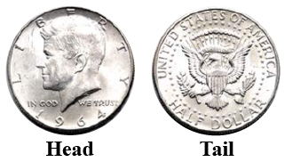
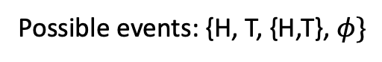
Event
An event is a subset $A⊆Ω$ to which a probability may be assigned
Possible events: {H, T, {H,T}, $φ\}$

Slide 5
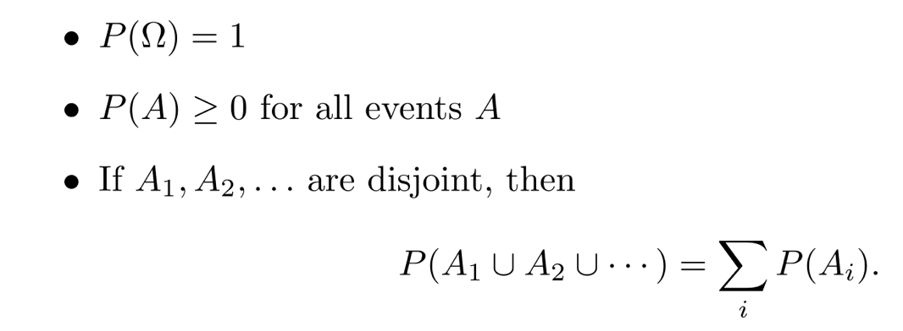
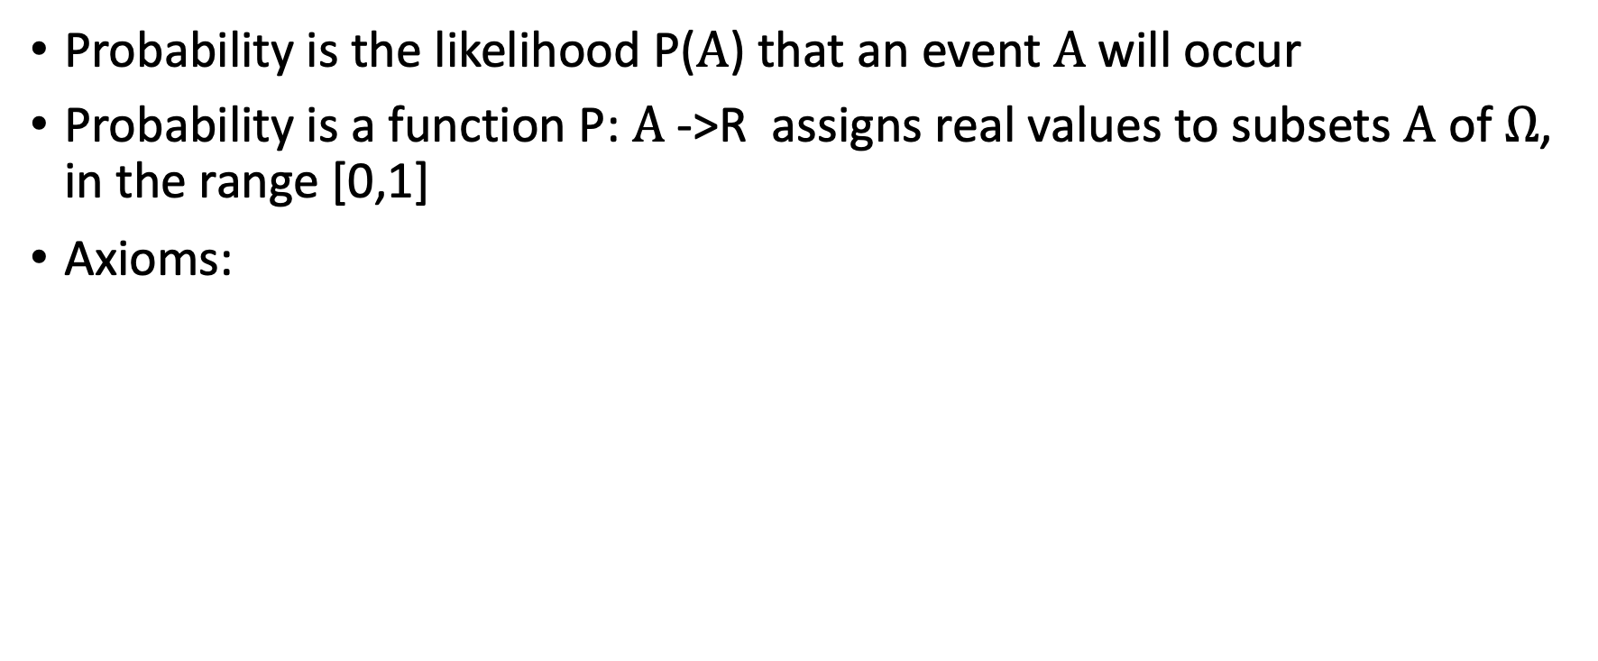
Probabilities
Probability is the likelihood P($A$) that an event $A$will occur
Probability is a function P: $A$->R assigns real values to subsets $A$ of $Ω$, in the range [0,1]
Axioms:
Measure
Non-negativity
Additivity

Slide 6
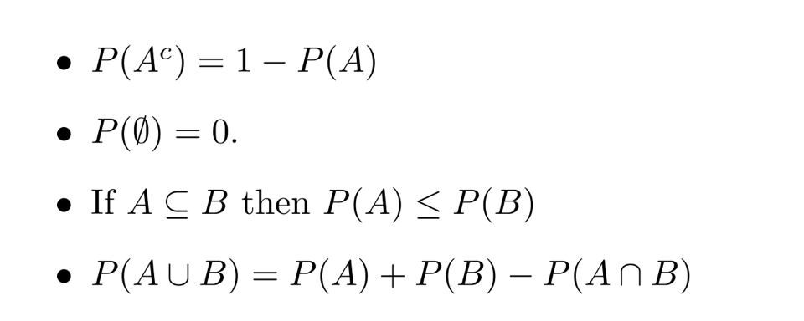
Other properties of Probability Distributions
A^{c} is complement set of A

Slide 7
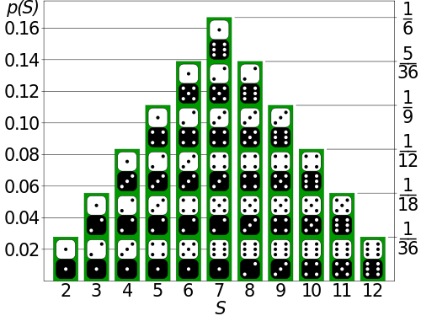
Probability Mass Function
Function that assigns probabilities to each outcome

Slide 8
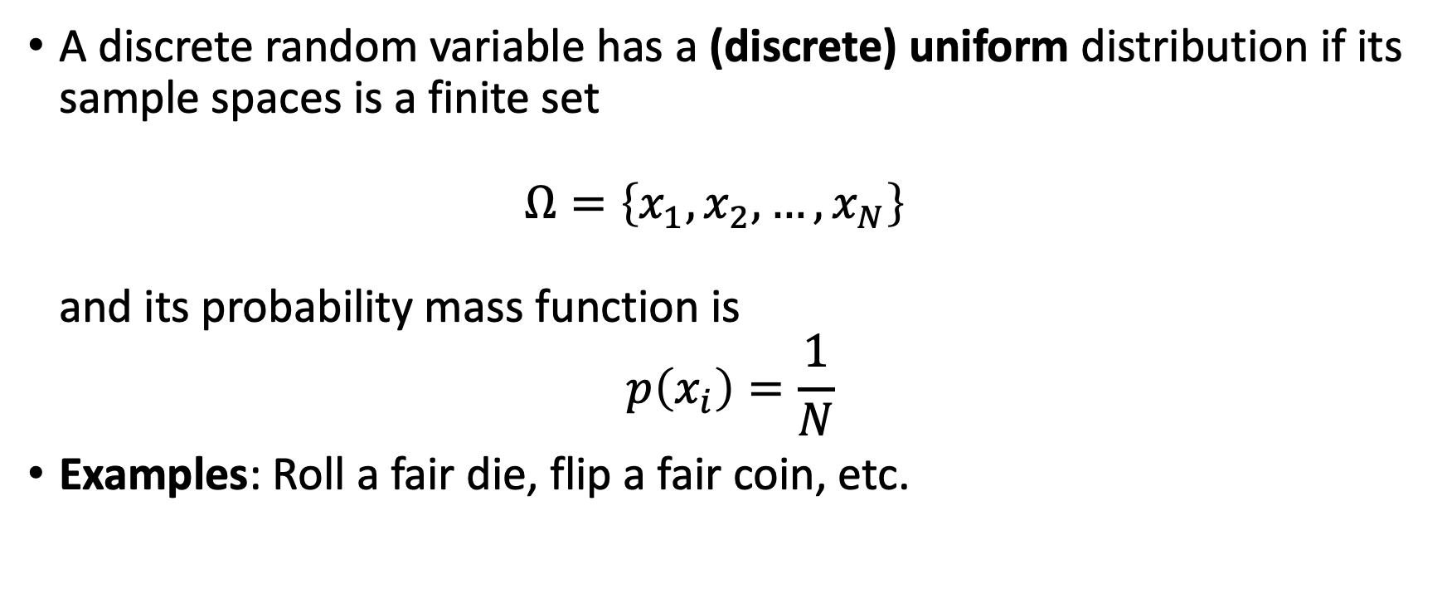
Discrete Uniform Distribution
has maximum entropy
A discrete random variable has a (discrete) uniform distribution if its sample spaces is a finite set $Ω=\left\{x_{1},x_{2},…,x_{N}\right\}$ and its probability mass function is
$$p\left(x_{i}\right)=\frac{1}{N}$$
Examples: Roll a fair die, flip a fair coin, etc.
equal probability for each outcome

Slide 9
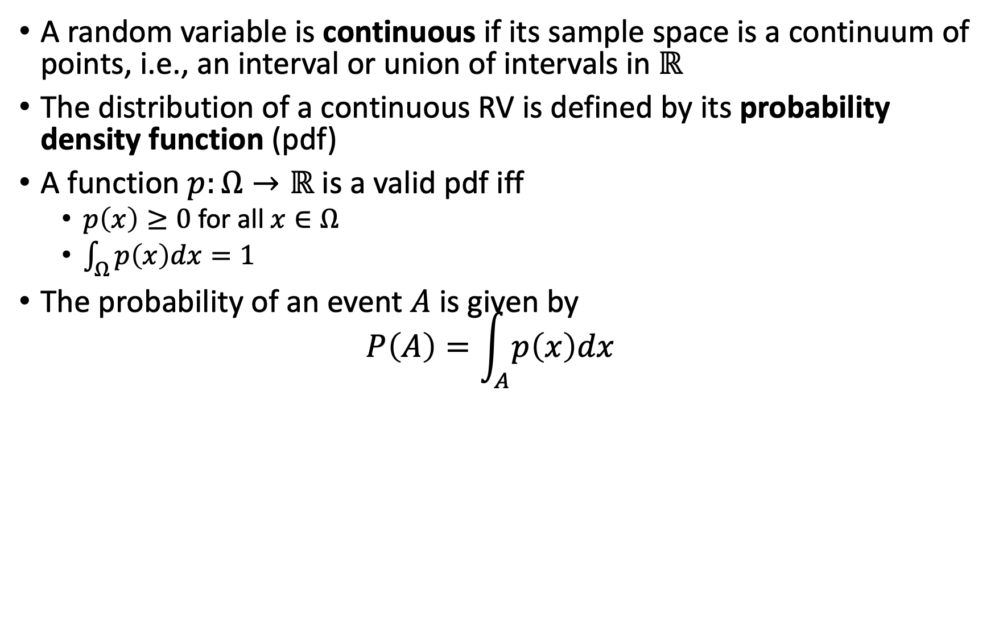
Continuous Random Variables
A random variable is continuous if its sample space is a continuum of points, i.e., an interval or union of intervals in $ℝ$
The distribution of a continuous RV is defined by its probability density function (pdf)
A function $p:Ω→ℝ$ is a valid pdf iff
$p\left(x\right)≥0$ for all $x∈Ω$
$\int_{Ω}^{ }{p\left(x\right)dx=1}$
The probability of an event $A$ is given by $P\left(A\right)=\int_{A}^{ }{p\left(x\right)dx}$

Slide 10
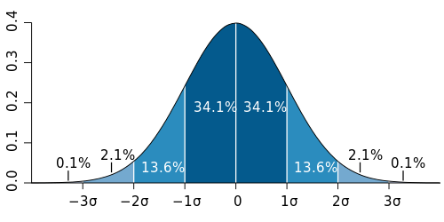
Probability Density Function
Describes the infinitesimal probability of any given value, and the probability that the outcome lies in a given interval can be computed by integrating the probability density function over that interval

Slide 11
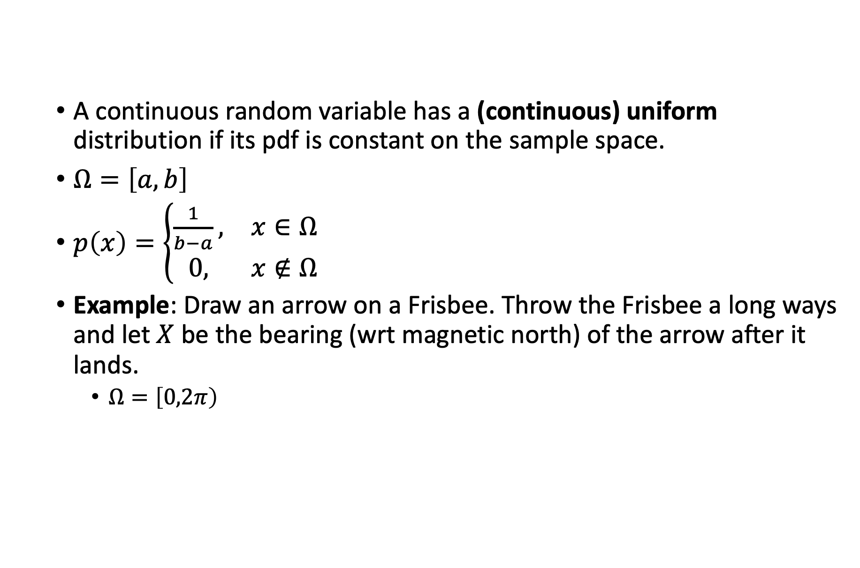
Continuous Uniform Distribution
A continuous random variable has a (continuous) uniform distribution if its pdf is constant on the sample space.
$Ω=\left[a,b\right]$
$p\left(x\right)=\left\{\begin{matrix}\frac{1}{b−a}, & x∈Ω \\ 0, & x∉Ω\end{matrix}\right.$
Example: Draw an arrow on a Frisbee. Throw the Frisbee a long ways and let $X$ be the bearing (wrt magnetic north) of the arrow after it lands.
$Ω=\left[0,2π\right)$
Notes:
在飞盘上画一个箭头，将飞盘扔得很远，让 𝑋 成为箭头着陆后的方位（相对地磁北极）。

Slide 12
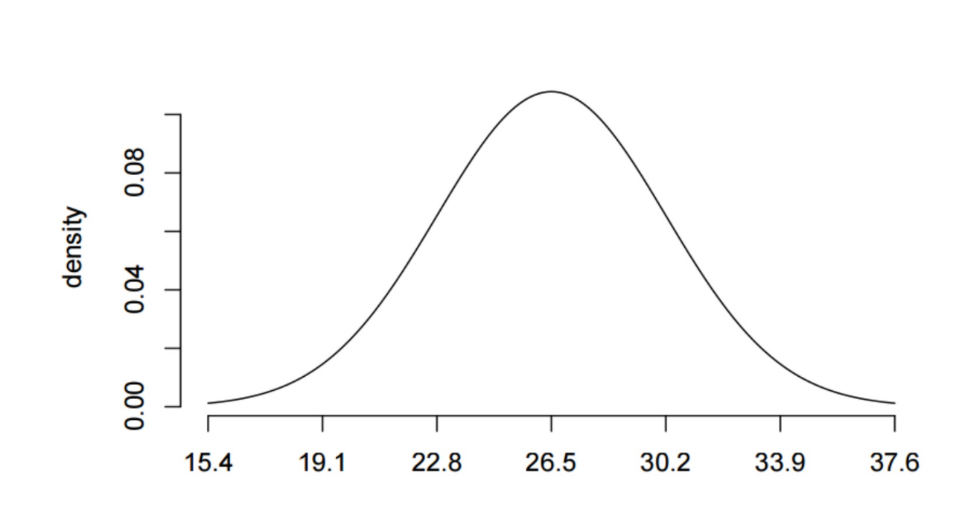
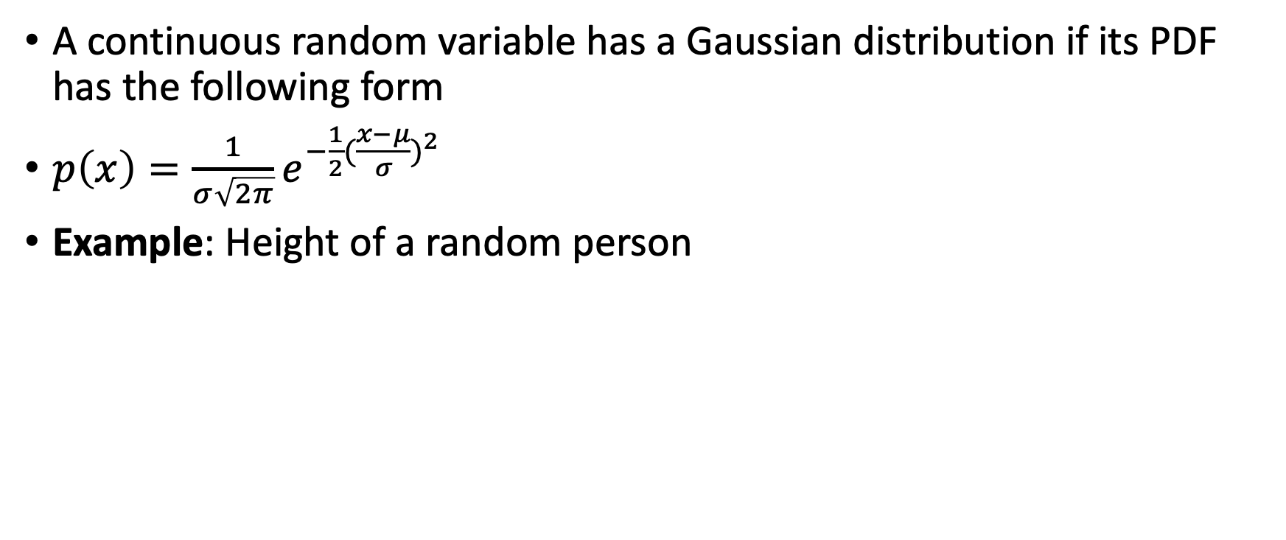
Gaussian Distribution
A continuous random variable has a Gaussian distribution if its PDF has the following form
$p\left(x\right)=\frac{1}{σ\sqrt{2π}}e^{−\frac{1}{2}({\frac{x−μ}{σ})}^{2}}$
Example: Height of a random person

Slide 13
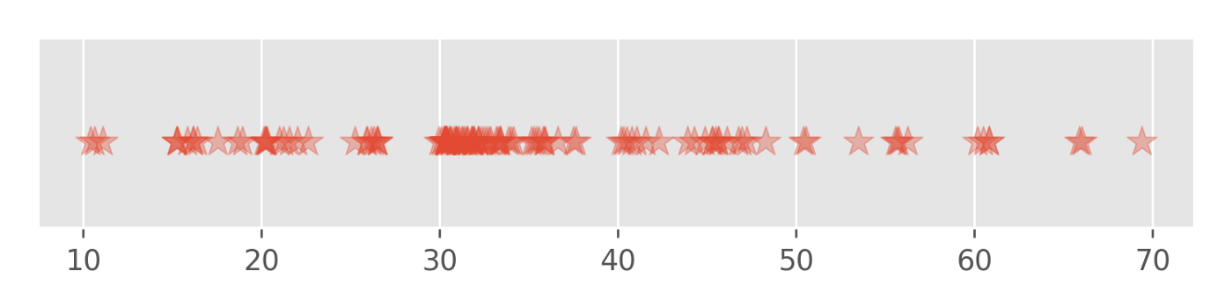
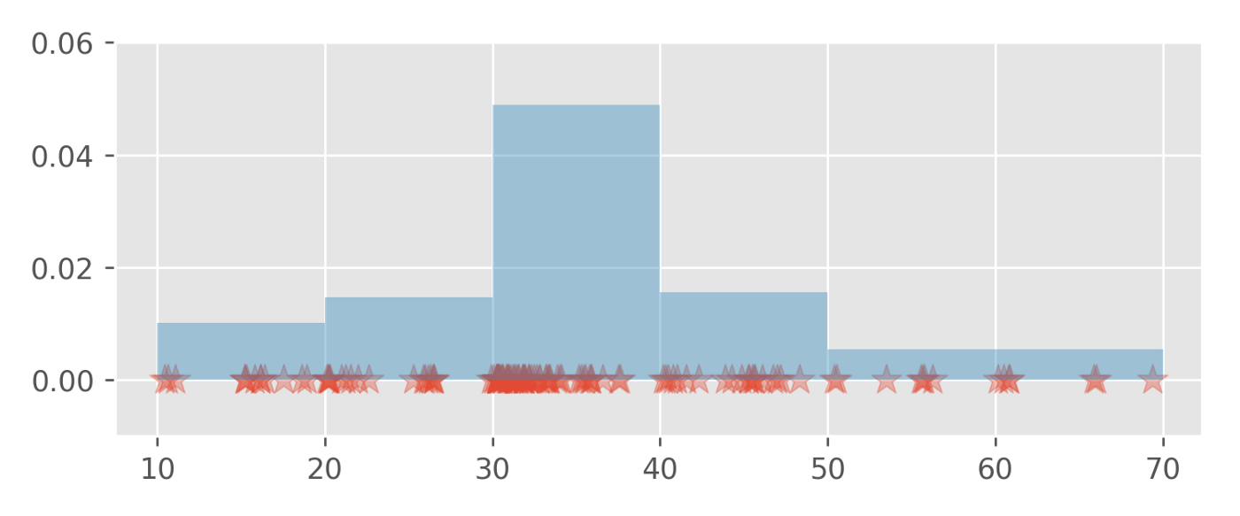
Real Data
Do not have PDF (parametric form)
Why we need to estimate PDF?
Generative/predictive model
Estimate mutual information
Capture inherent stochasticity
density estimate to compute entropy/info
Reason about outliers and noise

Slide 14
Non-parametric Estimate
Raw Data
pCD3z
pSLP76

Slide 15
Simple Approach: Histogram
draw a histogram to get distribution of data

Slide 16
O(N) Algorithm for Computation
Data X = (x₁, …, x_{N})
10 bins with width w=max(X)/10;
For i=1:N
val = ceil(x_{i}/w)
hist(val) = hist(val+1);
end

Slide 17
Width of bin “bandwidth” matters
10 bins
5 bins

Slide 18
Problems with Histograms
if the bandwidth of bin is too small
the distribution of data will be too jumpy,
not capture actual distribution of data
Non-smooth (gaps, jumps)
Discontinuous

Slide 19
Kernel Density Estimates

Slide 20
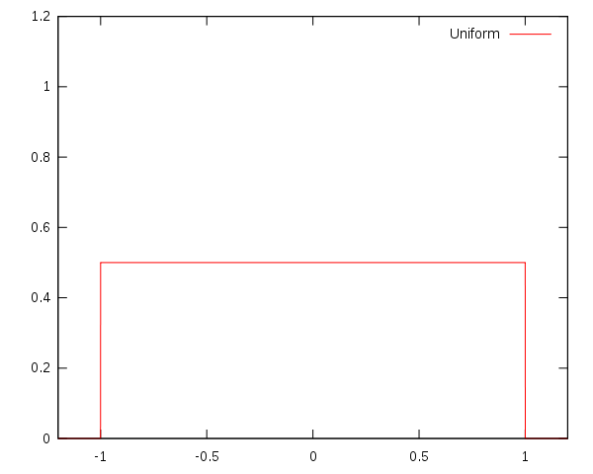
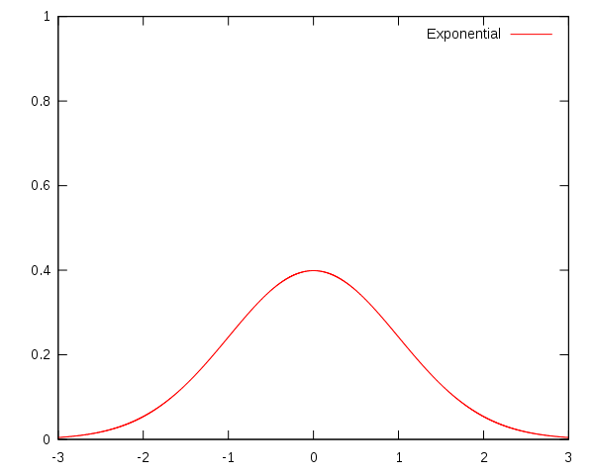
Kernel
A Kernel is a non-negative, real-valued, integrable function K that :
Integrates to 1
Symmetric K(-u)=K(u)
Uniform Kernel
Gaussian Kernel

Slide 21
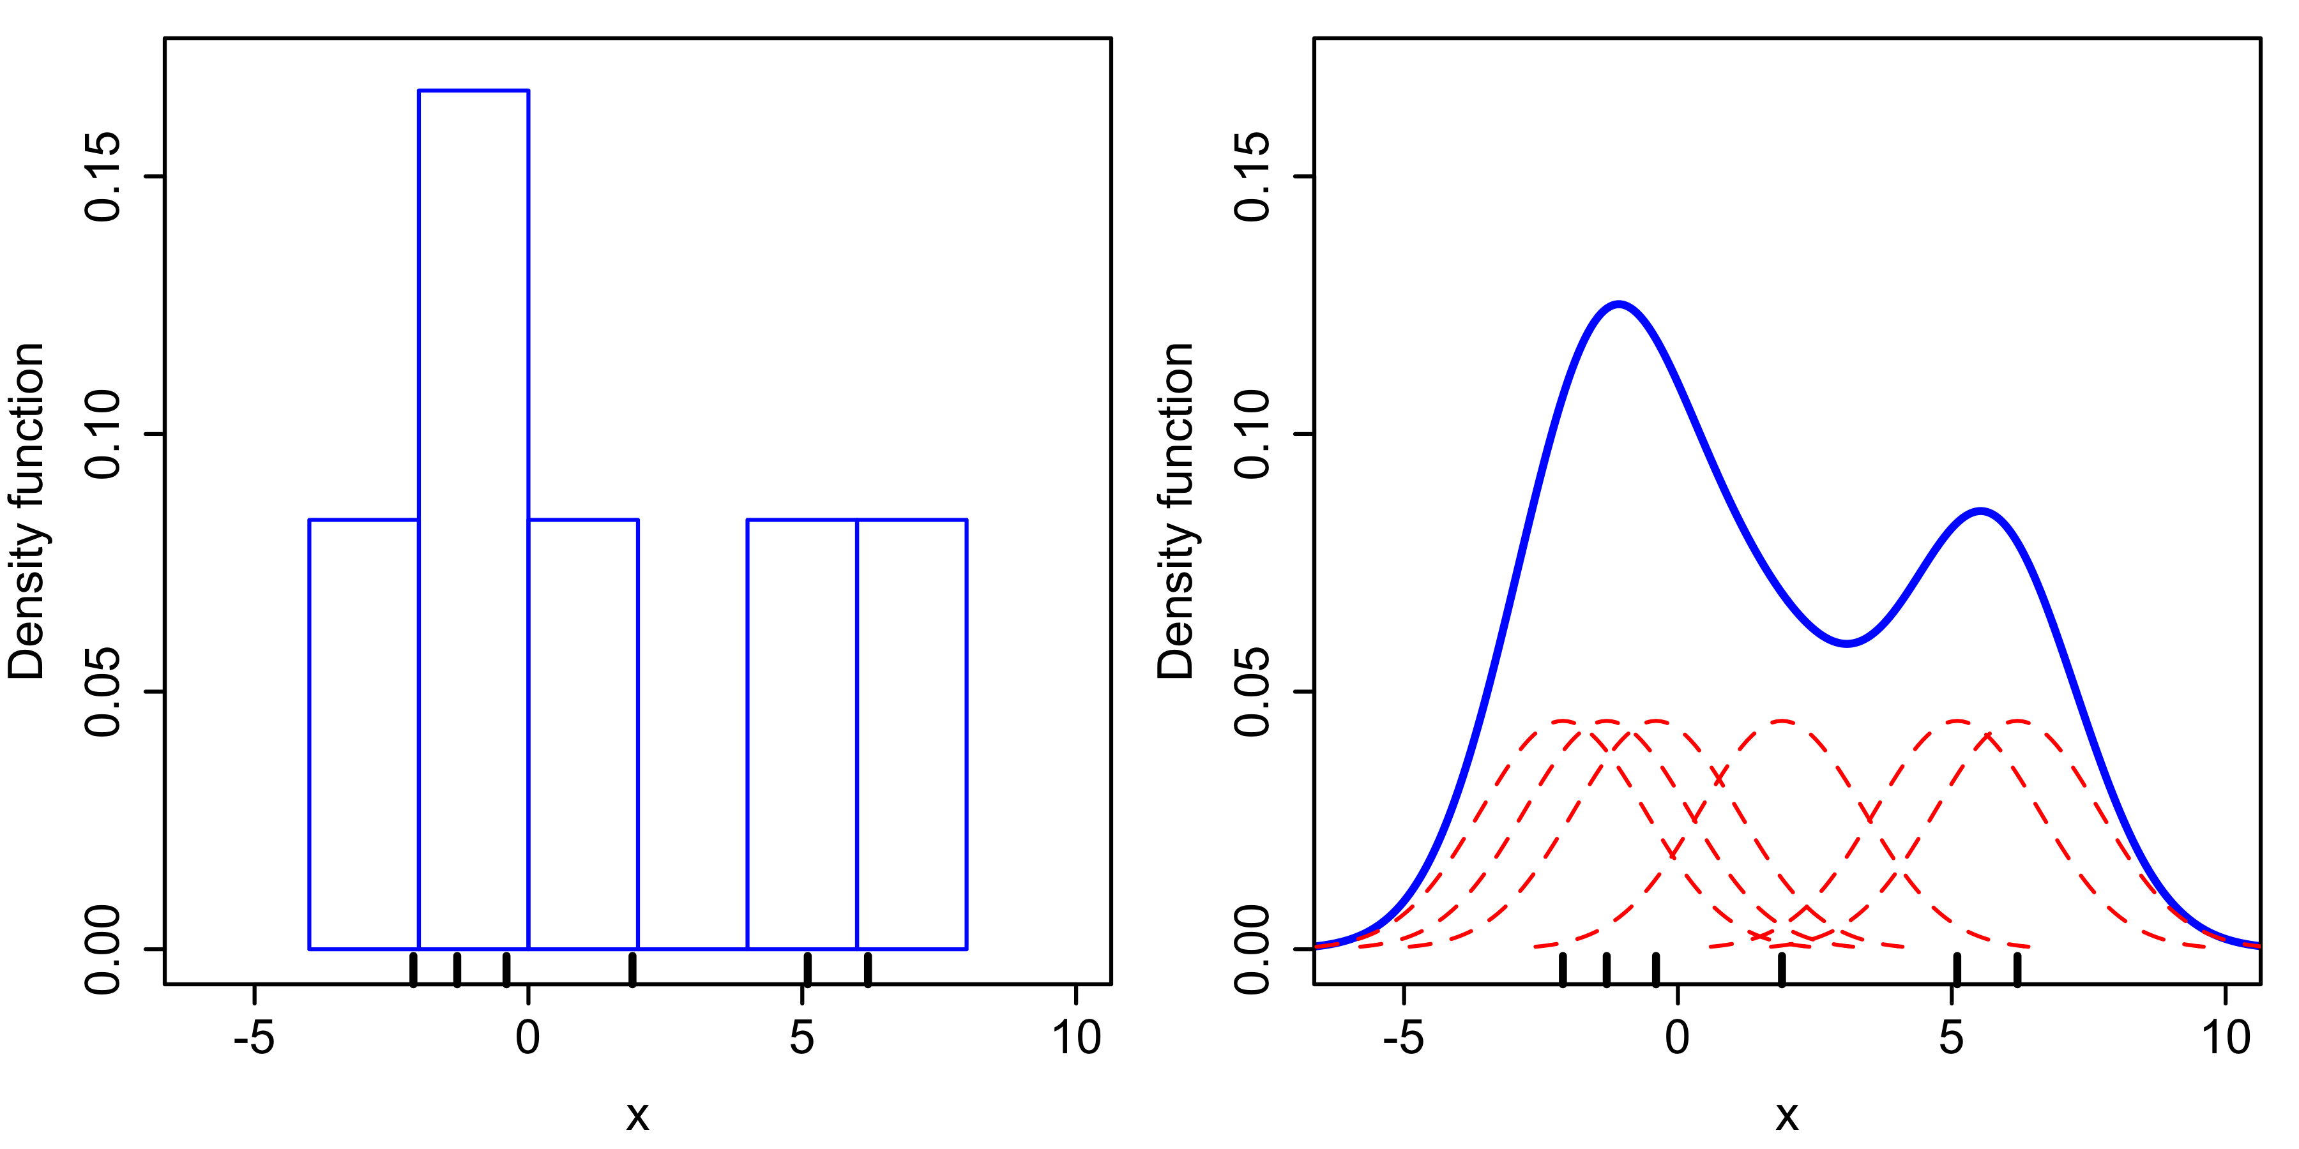
Kernel Density Estimate
[Wikipedia]
Scale Kernel By Bandwidth
Integrate over all Kernels

Slide 22
Density Estimate
Gives a smooth approximation to density
Interpolates gaps

Slide 23
Bandwidth= h =Width of Scaled Kernel K_{h}
Optimal*
Bandwidth
Lower bandwidth
undersmooths
Higher bandwidth
oversmooths

Slide 24

Kernel Density Estimation in 2D
KDE learns underlying probability distribution, smooths data
Raw Data
Integrate over space
Mini-Kernel (Gaussian) at each point
Rendered as Heatmap

Slide 25
KDE Algorithm O(N*P)
KDE is computed by :
Suppose we want to compute KDE at points
for j=1:P
for i=1:n
end
end

Slide 26
Mean Integrated Square Error
Problem: we don’t know the actual distribution!
Solution: Approximate it with a Gaussian and solve for optimal bandwidth (“rule-of-thumb” estimate)
KDE
Actual

Slide 27
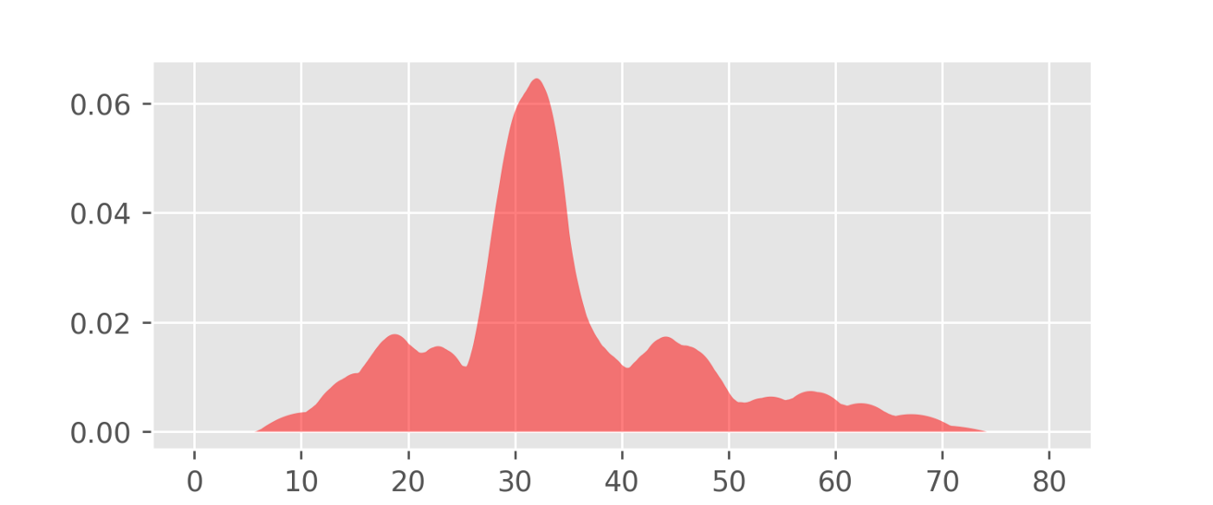
Data, Histogram, Density Estimate

Slide 28
k-NN-based Density Estimate

Slide 29
Example: ND Density Estimation on k-NN
Compute KNN with 2d distance
r =Distance to k-th neighbor
k/N point are within R² ball of t
In higher dimensions use the volume of the higher dimensional ball
[Loftsgaarden, Quesenberry, Annals of Mathematical Statistics, 1965]
t
y
R
Kth neighbor
x

Slide 30
Sklearn density estimation
from sklearn.neighbors import KernelDensity
https://scikit-learn.org/stable/modules/density.html

Slide 31
More advanced KDE

Slide 32
Heat-Equation Based Density-Estimation

Slide 33
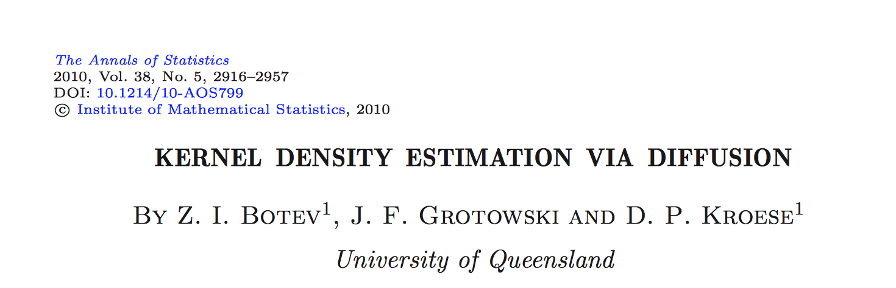
Main idea:
Start with histogram
Smooth histogram using heat equation evolution
Mimics spreading of heat

Slide 34
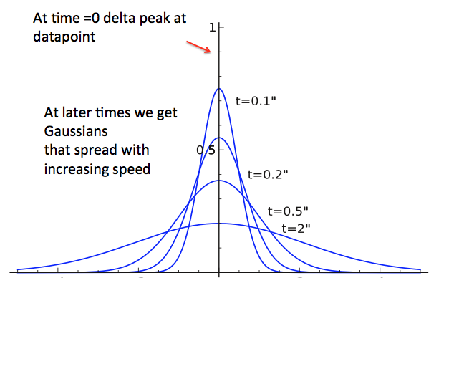
Spreading of Heat
At time=0 we have at
delta peak at 0
At later times we get
Gaussians that spread
faster and faster

Slide 35
Heat Equation
Relates diffusion of heat in time related to diffusion in space
Heat diffuses over larger areas with time
Starts with peaks at each datapoint, and spreads to a uniform equilibrium over time
Notes:
Spread the probability, the rate I am going to move is proportional to the concentration

Slide 36
Frequency Domain
Neumann boundary conditions: no probability mass is allowed past data range
Solution the heat equation in a bounded domain is given by a Fourier series in Cosines:

Slide 37
Discrete Cosine Transform
DCT is a representation of a dataset as a sum of cosines
Used often in compression techniques like JPEG

Slide 38
Histogram->DCT
Most information is in first few coefficients

Slide 39
Evolving the DCT through “Heat”
Very simple in the frequency domain
Multiply each coefficient by an exponential
t=h²: Time of evolution is bandwidth squared
m^{th} coefficient of DCT
of the histogram
Multiplied by decaying
exponential in t

Slide 40
DCT Before and After Smoothing

Slide 41
Invert the DCT
Smooth estimate
Higher Dimensions Generalize from 1-D Case

Slide 42
Sketch of Algorithm (matlab command in blue)
Start from an equi-binned histogram (histc)
Transfer histogram into frequency domain via Discrete Cosine Transform (dct)
3. Evolve DCT by heat equation
4. Inverse Discrete Cosine Transform (idc)

Slide 43
Implementations of KDE
Matlab has an implementation in 1D of the gaussian kernel density estimation: ksdensity
Can use other kernel shapes
Heat-equation based KDE implementation by Botev, et al. for 2D
Kde2d.m
Our implementation in 3-D case available

Slide 44
Complexity Analysis
O(N) to compute histogram
O(M log M) to compute DCT of an M-binned histogram using a Fast Cosine Transform (like fast fourier transform)
O(M) to smooth DCT
O(M log M) to invert DCT
Overall complexity O(N+M log M)

Slide 45
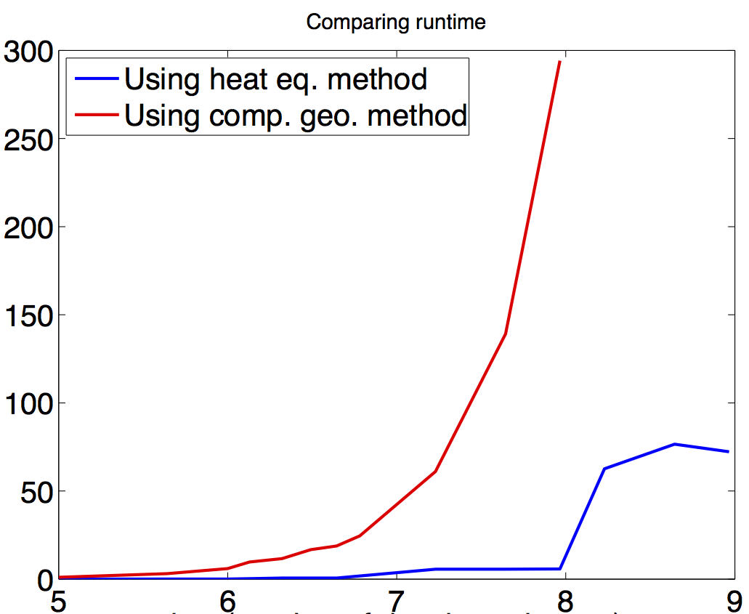
Runtime Analysis
Runtime(s)
Log₂(number of bins)

Slide 46
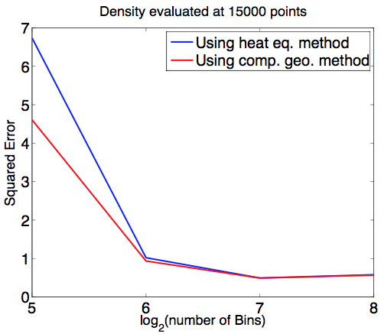
Error Analysis-2
1. Learn a distribution on full
data using Gaussian kde
2. Sample out a trainset from
the histogram
3. Learn a distribution using
both methods from the
train set
4. Compare to estimates
obtained in step 1.

